Slide 1
Beyond Strickland: The Search for Other Kinds of Golden Tickets
Amelia Bizzaro &
Jonathan M. Kirshbaum
December 5, 2019

Slide 2
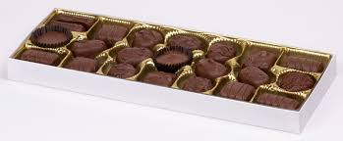
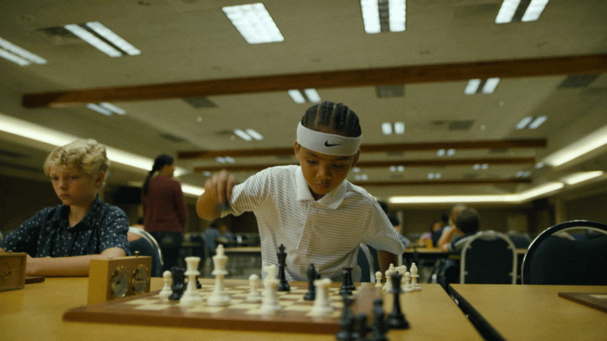
Life is like a game of chess . . .

Slide 3
Claims Beyond IAC
Brady violations
Napue violations
Jury Misconduct
Judicial Bias
Actual Innocence
Evolving Science

Slide 4
Brady Standard
Three Elements to a Brady Violation
1. Favorable
Impeachment or Exculpatory
2. Suppression
3. Materiality
Reasonable Probability or Possibility
Notes:
“there is a reasonable probability that, had the evidence been disclosed to the defense, the result of the proceeding would have been different.” U.S. v. Bagley, 473 U.S. 667, 682 (1985). A reasonable probability is one “sufficient to undermine confidence in the outcome.” Id. specific request: there exists a reasonable possibility

Slide 5
Brady Corollary - Napue
State may not use false evidence to obtain a criminal conviction. Napue v. Illinois, 360 U.S. 264, 269 (1959).
Elements:
1. testimony was false
2. knew or should have known
3. material
“any reasonable likelihood that the evidence could have affected the judgment of the jury.”
Notes:
“The Napue materiality standard is less demanding than Brady.” Reis-Campos v. Biter, 832 F.3d 968, 976 (9th Cir. 2016).

Slide 6
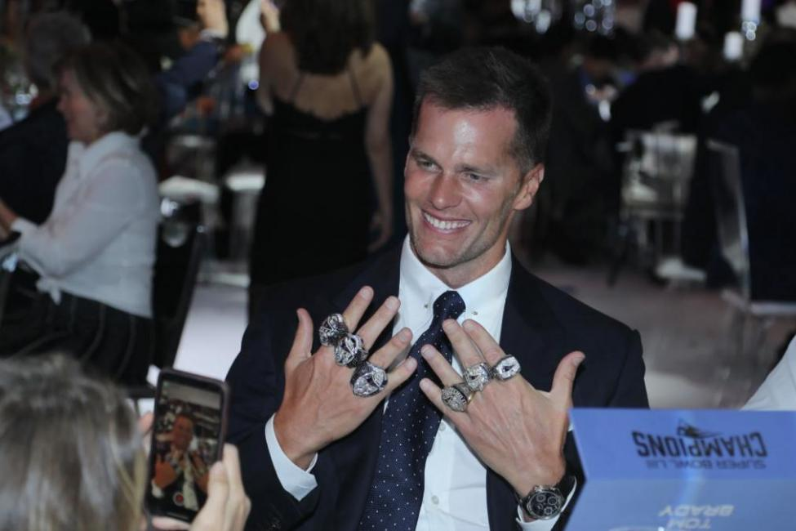
Brady Trivia
Over 150 Decision from NSC on Brady
Only FOUR times has NSC found a Brady violation
All four between 1996 and 2003

Slide 7
On the Other Hand . . .
“There is an epidemic of Brady violations abroad in the land. Only judges can put a stop to it.”
United States v. Olsen, 737 F.3d 625, 626 (9th Cir. 2013) (Kozinski, J., dissenting from denial of en banc petition)

Slide 8
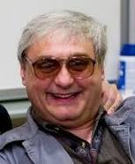
Ninth Circuit Brady
2254 Habeas Cases Alone
Since 2003, Ninth Circuit has granted relief under Brady 11 times
Move that back to 2000, 14 times

Slide 9
The Upside Down Happy Kozinski’s
Browning v. Baker, 871 F.3d 941 (9th Cir. 2017)
Comstock v. Humphries, 786 F.3d 701 (9th Cir. 2015)
Amado v. Gonzalez, 758 F.3d 1119 (9th Cir. 2014)
Aguilar v. Woodford, 725 F.3d 970 (9th Cir. 2013)
Milke v. Ryan, 711 F.3d 998 (9th Cir. 2013)
Phillips v. Ornoski, 673 F.3d 1168 (9th Cir. 2012)
Maxwell v. Roe, 628 F.3d 486 (9th Cir. 2010)
Silva v. Brown, 416 F.3d 980 (9th Cir. 2005)
Gantt v. Roe, 389 F.3d 908 (9th Cir. 2004)
Bailey v. Rae, 339 F.3d 1107 (9th Cir. 2003)
Goldstein v. Harris, 82 F. App’x 592 (9th Cir. 2003)
Benn v. Lambert, 283 F.3d 1040 (9th Cir. 2002)
Killian v. Poole, 282 F.3d 1204 (9th Cir. 2002)
Paradis v. Arave, 240 F.3d 1169 (9th Cir. 2001)

Slide 10
Brady – How the NSC Gets It Wrong
Materiality Standard
Wearry v. Cain, 136 S. Ct. 1002 (2016)
“Evidence qualifies as material when there is ‘“any reasonable likelihood”’ it could have ‘“affected the judgment of the jury.”’”
“Given this legal standard, Wearry can prevail even if, as the dissent suggests, the undisclosed information may not have affected the jury's verdict.”
But see Overton and Turner
Due Diligence

Slide 11
Case Studies: Brady and Napue

Slide 12
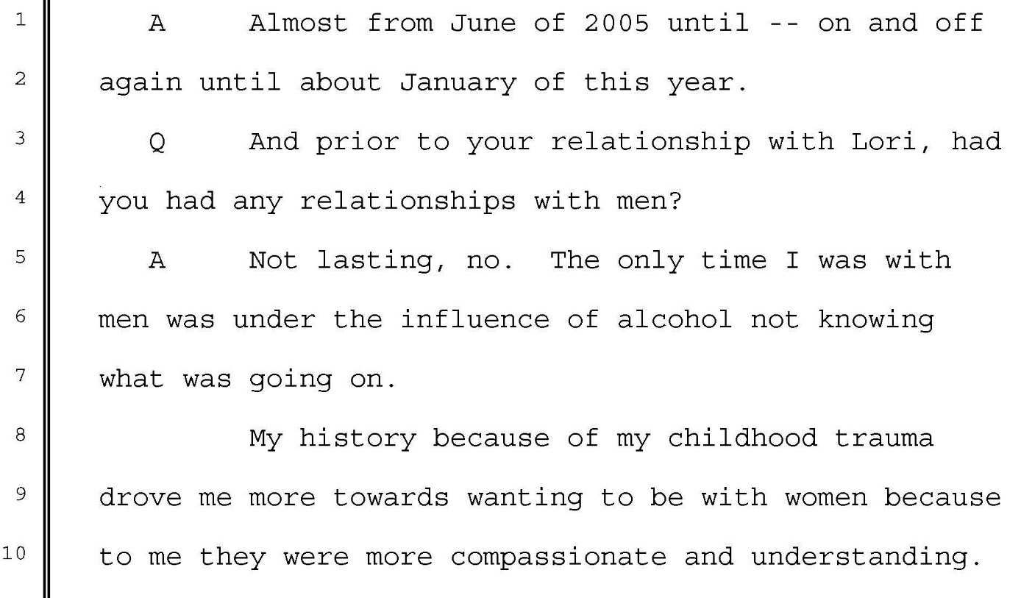
This Really Happened

Slide 13
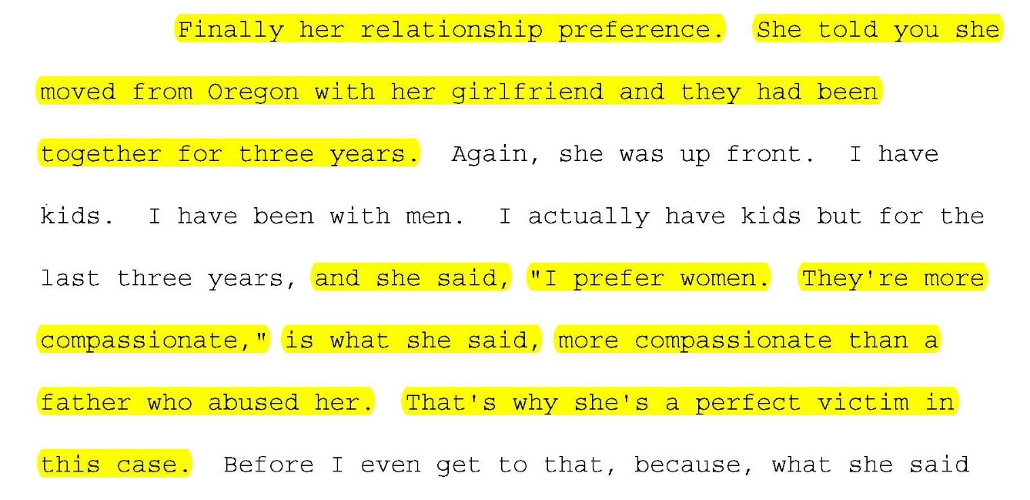
This Really Happened

Slide 14
This Really Happened
Investigation
Girlfriend – Nobody had spoken with her
Made the off hand remark that the victim left town soon after the incident because she had become pregnant and did not want the father, a man named Jim, to know about it
Could this be Brady?
Suppression?

Slide 15
This Really Happened

Slide 16
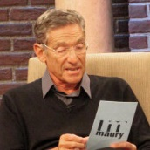
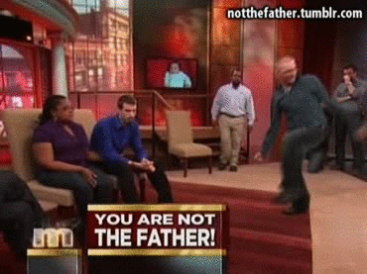
This Really Happened
baby,
the victim
the defendant
Defendant
the baby!

Slide 17
Brady Questions
Suppression
Prosecutor’s office is an entity
Prosecution has duty to learn all info in possession of State agents working on the case
Duty to disclose continues at least through trial
Favorable
Impeachment
Calls into doubt State’s theory
Material
Prosecution’s word best indication of materiality
Victim’s credibility was central to the case
Close evidentiary case

Slide 18
This Also Really Happened
him

Slide 19
This Also Really Happened

Slide 20
Lessons?

Slide 21
Sources of Brady Material
Vouchers in Comptroller’s Office
Jail/Prison Records, including Visiting Logs
Local Police Records
Interagency Records, such as state law enforcement
Social Security Adminstration
DCFS Records
Parole Hearings – Recorded and Publicly Available
Federal records (very tricky, but within the realm of possibility)
DA’s file, including any co-defendants, snitches
Witnesses and Snitches themselves
Depositions, Interrogatories

Slide 22
Jury Misconduct
Internal Misconduct
External Influence

Slide 23
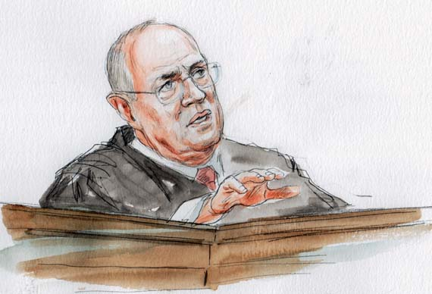
A New Avenue for Investigation
“[W]here a juror makes a clear statement that indicates he or she relied on racial stereotypes or animus to convict a criminal defendant, the Sixth Amendment requires that the no-impeachment rule give way . . . .”
Internal
No impeachment rule
Howeva!!
Pena-Rodriguez v. Colorado, 137 S. Ct. 855, 869 (2017)

Slide 24
Other Internal Jury Misconduct
Misconduct during Voir Dire
Juror failed to honestly answer a material question
Correct response would have provided a valid basis for a cause challenge
Brioady v. State, 133 Nev. 285, 396 P.3d 822 (2017)

Slide 25
Juror Misconduct
External Influence
Any private communication, contact, or tampering, directly or indirectly, with a juror during a trial about the matter pending before the jury is presumptively prejudicial.
Remmer v. United States, 347 U.S. 227, 229 (1954)

Slide 26
Case Studies: Juror Misconduct

Slide 27
Las Vegas’s Finest
Metro Mike’s Pigs in a Blanket

Slide 28
Las Vegas’s Finest

Slide 29
External Influence in Federal Court
Two-Step Inquiry
1. Was contact “possibly prejudicial”?
2. State must overcome heavy burden that it was presumptively prejudicial.
Step One
External contact has a tendency to be injurious to the defendant and must raise a credible risk of influencing the verdict
Godoy v. Spearman, 861 F.3d 956 (9th Cir. 2017)
Government Agent
Tarango v. McDaniel, 837 F.3d 936 (9th Cir. 2016)

Slide 30
External Influence
Nevada Supreme Court is getting this standard wrong
Meyer v. State, 119 Nev. 554, 564, 80 P.3d 447, 455 (2003)
Places the burden on defendant, instead of State
Paves the way for independent federal review of this claim

Slide 31
Tracking Down Jurors

Slide 32
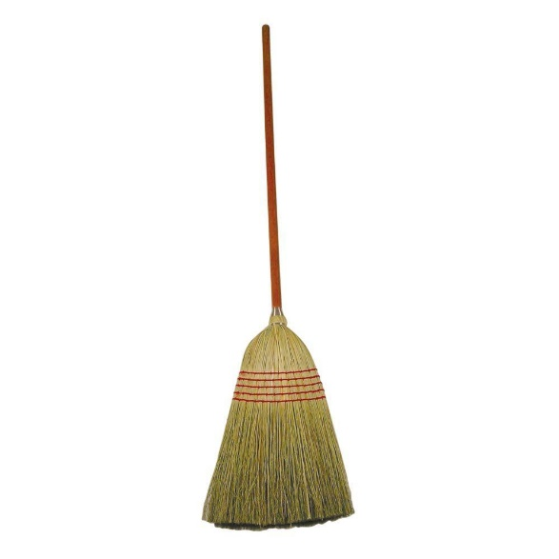
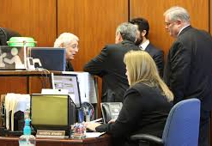
Another Example
Habeas Victory Based on Newly Discovered Evidence of External Influence on the Jury’s Deliberations!

Slide 33
Case Studies: Judicial Misconduct

Slide 34
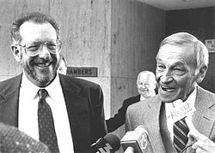
Nevada and Judicial Bias
Harry Claiborne
and
Oscar Goodman
Notes:
1984 U.S. District Court Judge Harry Claiborne becomes first federal judge to serve a prison sentence while serving on the bench.
See J.M. Kalil & Carri Greer Thevenot, Ex-federal judge Claiborne kills self, Las Vegas Review-Journal, Jan. 21, 2004 at 1A, 2004 WLNR 918138 (“Though some believed Claiborne was a member of Southern Nevada’s good ol’ boy network, who had been caught breaking the law, many believed there was truth to Claiborne’s allegations that he was wrongfully accused by a vengeful Justice Department.”).

Slide 35
Judicial Misconduct
Actual Bias
Bribery
Financial stake
Notes:
“it certainly violates the Fourteenth Amendment and deprives a defendant in a criminal case of due process of law to subject his liberty or property to the judgment of a court, the judge of which has a direct, personal, substantial pecuniary interest in reaching a conclusion against him in his case.” Tumey v. Ohio, 273 U.S. 510, 523 (1927).

Slide 36
Judicial Misconduct
Potential Bias
Objective question
Likely to be neutral?
“Potential for bias?”
Notes:
In determining whether recusal is required, “[t]he inquiry is an objective one. The Court asks not whether the judge is actually subjectively biased, but whether the average judge in his position is ‘likely’ to be neutral, or whether there is an unconstitutional ‘potential for bias.’” Caperton v. A.T. Massey Coal, Co., 556 U.S. 868, 881 (2009); see also Hurles v. Ryan, 752 F.3d 768, 788-89 (9th Cir. 2014).
In light of Rippo, actual bias is probably going to be replaced altogether by this potential bias standard. Rippo v. Baker, 137 S. Ct. 905, 907 (2017) (discussing Bracy: “Although we explained that the petitioner there had pointed to facts suggesting actual, subjective bias, we did not hold that a litigant must show as a matter of course that a judge was ‘actually biased in [the litigant’s] case,’ . . . –much less that he must do so when, as here, he does not allege a theory of ‘camouflaging bias.’”

Slide 37
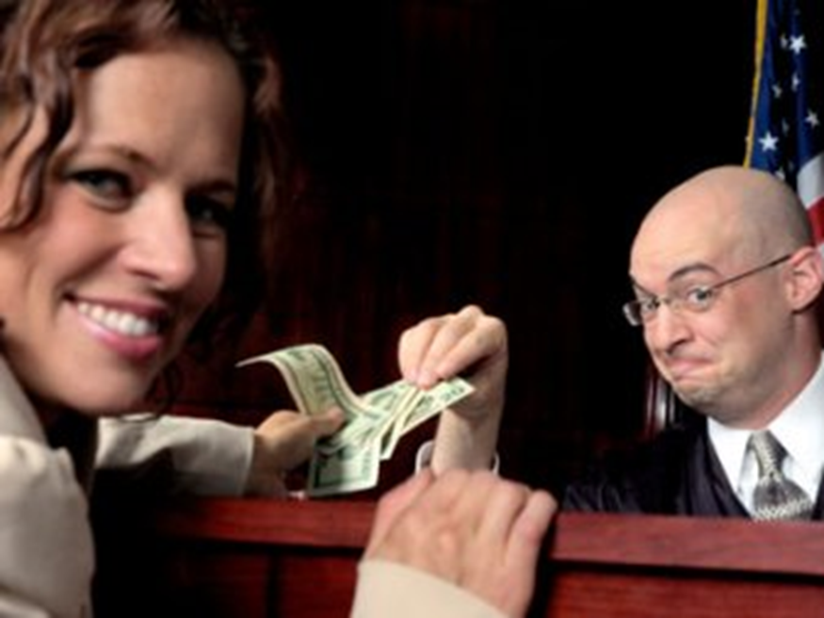
Rippo v. Baker
Judge Bongiovanni taking bribes?
Notes:
Judge Bongiovanni was being investigated for taking bribes.

Slide 38
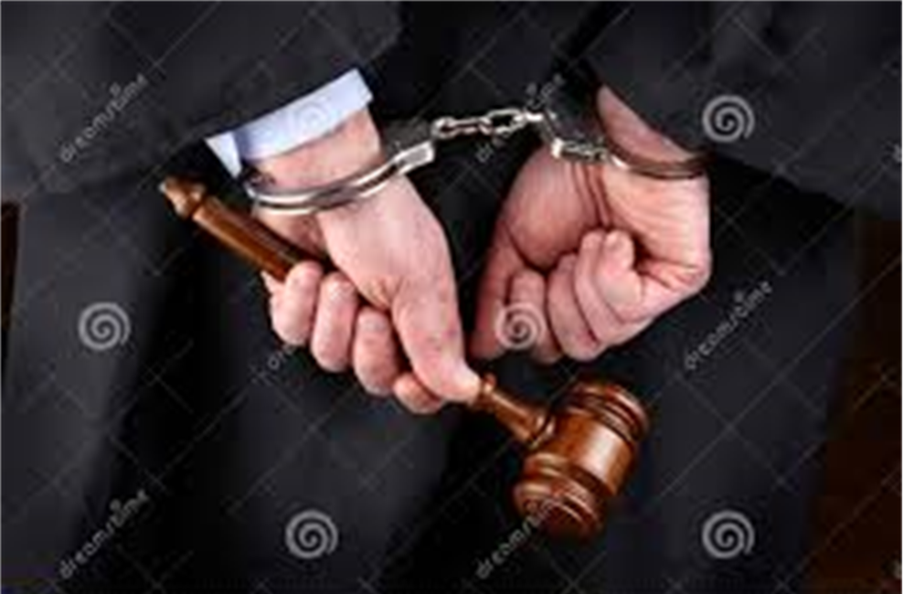
Rippo v. Baker
Marked bills in the pants pocket
Notes:
In a sting operation, after he accepts a “bribe,” he is arrested at home with marked bills in his pocket.

Slide 39
Rippo v. Baker
Representations at trial
Representations during 2nd Post-conviction
Notes:
At trial, the Clark County District Attorney’s office indicated they had nothing to do with the federal corruption investigation into Judge Bongiovanni. Judge Bongiovanni indicated that he also did not know that the CCDA or Metro had anything to do with the investigation.
During post-conviction, we presented evidence that in fact the DA was heavily involved in the federal investigation. They arranged for a fake case to go through Judge Bongiovanni’s court. Metro was also involved, in the arrest. The judge knew that the DA and Metro were involved at the time of Rippo’s case.
Potential for bias in favor of the DA’s office

Slide 40
Federal Review
“We vacate the Nevada Supreme Court's judgment because it applied the wrong legal standard.”
Rippo v. Baker, 137 S. Ct. 905 (2017)

Slide 41
Important Investigation Point
Judicial bias was raised on appeal
At that time, there were limitations to investigate the claim earlier
But new evidence became available later on
Lesson: May want to look at direct appeal claims to see whether they can be further investigated

Slide 42
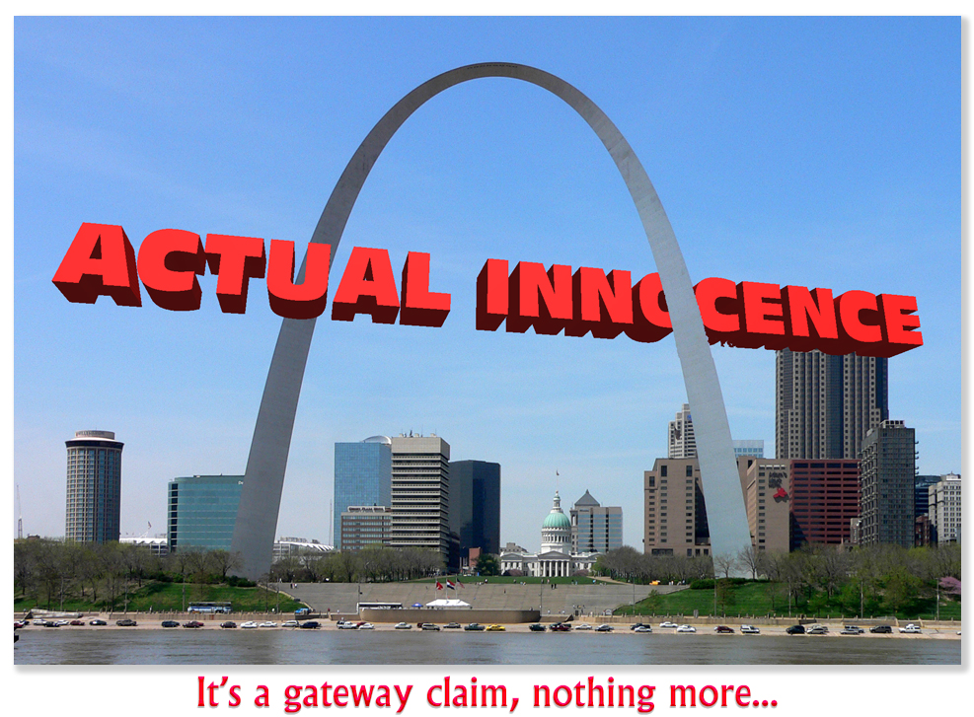

Slide 43
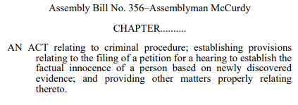

Slide 44
Flawed Scientific Evidence
“[H]abeas petitioners can allege a constitutional violation from the introduction of flawed expert testimony at trial if they show that the introduction of this evidence ‘undermined the fundamental fairness of the entire trial.’”
Gimenez v. Ochoa, 821 F.3d 1136, 1145 (9th Cir. 2016)
Notes:
Use of flawed forensic evidence at trial violated the right to due process because no reasonable juror would have convicted but for the introduction of the flawed testimony. Even if it was true at the time – and our expert agreed she would have said something similar – advancements in science now show it to be flawed. So take what was said then plus what would be testified now = no reasonable juror would convict.

Slide 45
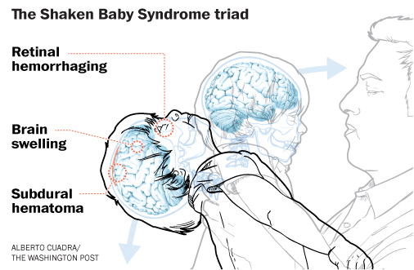
Notes:
State argued at trial it was medically impossible for Tamara to die from a short fall. They said her injuries: retinal hemorrhages, cerebral edema and subdural hemorrhages could only be the result of the intentional infliction of force, SBS. The last person with her was hanson, therefore he did it.

Slide 47
Notes:
In the intervening 20 years, advancements in science demonstrate that the
testimony at trial was wrong. In fact, Tamara’s injuries could have resulted from a small fall. And even though some medical professionals are not willing to completely let go of shaken baby syndrome (now called Abusive Head Trauma in
response to the changing science, Baker’s expert, Dr. Sandra Cetl, agreed that it was unacceptable today to conclude
that the mere existence of retinal hemorrhages, cerebral edema, and subdural hemorrhages means that a child was abused.

Slide 48
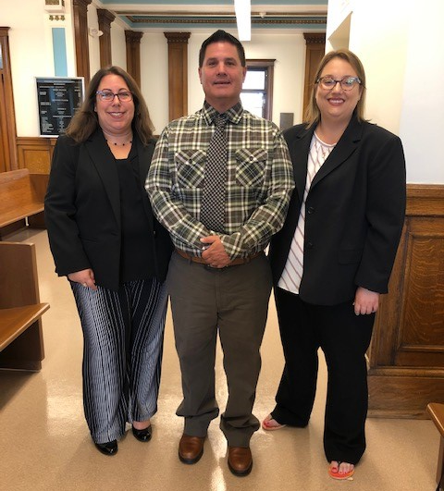

Slide 50
Beyond Strickland
Brady, Jury Misconduct, Judicial Misconduct
NSC is getting the law wrong on many of these claims
Opens the door to independent federal review.

